Slide 1
NTN Diversity: Matlab
Aris Timotijevic

Slide 2
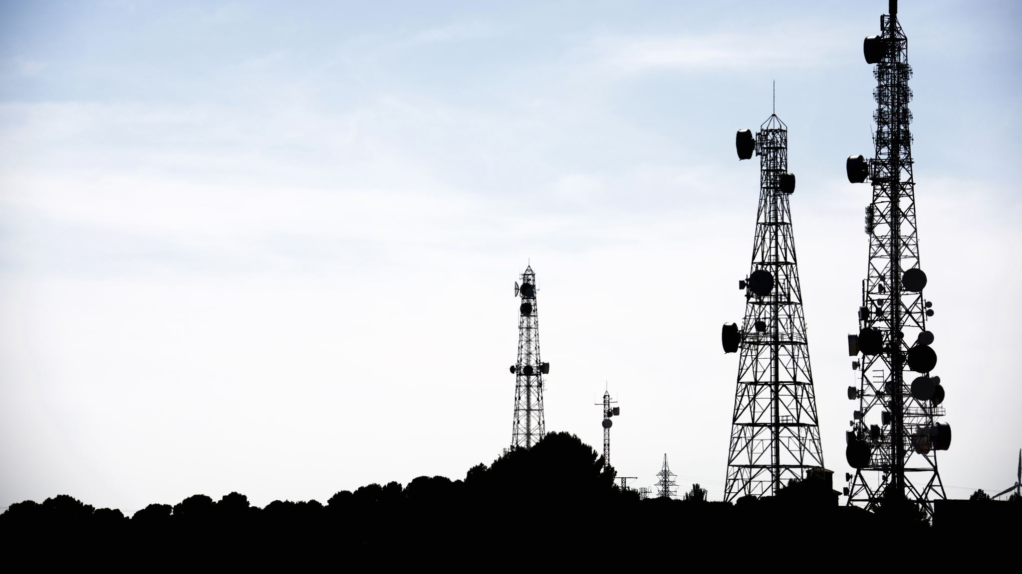
Definition of Diversity
Diversity → Redundancy of Resources
Resources
Space (Leveraging Multipath or Equipment)
Time (Multiple Transmissions in different slots)
Frequency
Diversity in Satellites
Multiple Antenna Systems (Both on UE/VSAT and SAT)
Multiple Satellites to one UE/VSAT
Methods at the Transmitter: MRT, Precoding
Methods at the Receiver: SC, MRC

Slide 3
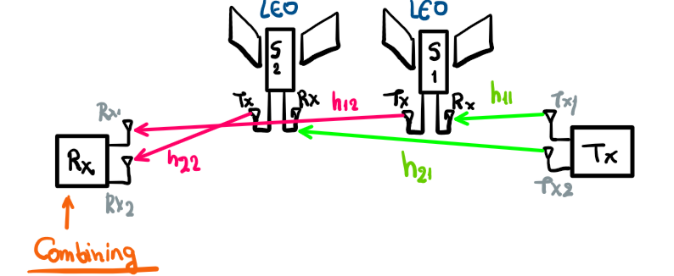
System Model
Spatial Diversity
Two Not-generative payloads
Two Antennas at Tx and Rx
The channel gains are both complex RVs, following Rician Distribution
In MATLAB simulation simple Friis is used.
The Satellites are invisible nodes → No contribution to delay and path loss or channel gain
Final channel gain is the product of the channel gains on each path
Antennas are directive, no multipath.
There is mechanical steering (Pointing)

Slide 4
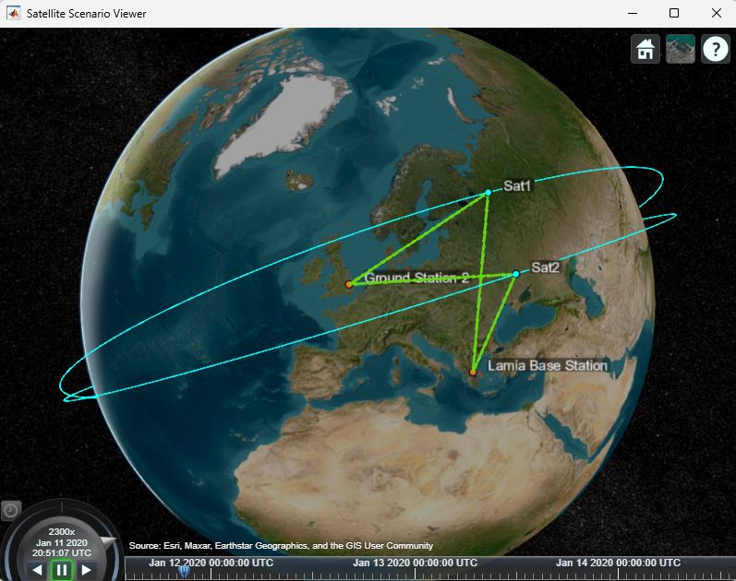
MATLAB Simulation – 1/8
Satellite Toolbox
Aerospace Toolbox + DSP Toolbox
Utilities
Scenario visualization
Satellite Geometry (Aerospace)
Path Loss, Delay, Doppler, Passes
Eb/No calculations
Mechanical Precision on Simulated Points
Average Pass Duration: 9’07’’
Average Delay: 132.3 msec

Slide 5
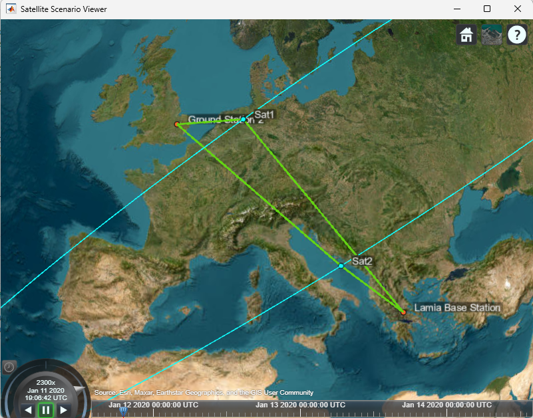
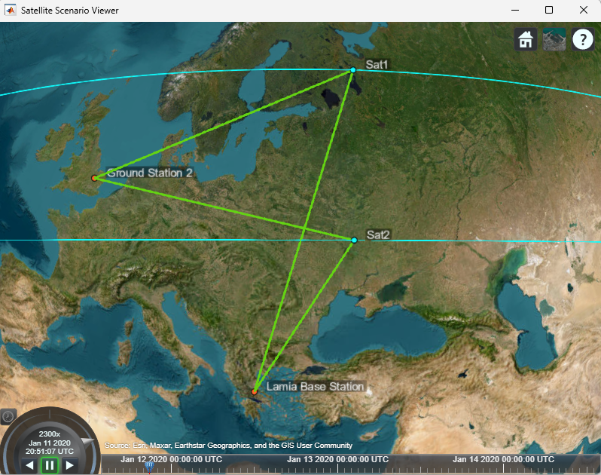
MATLAB Simulation – 2/8

Slide 6
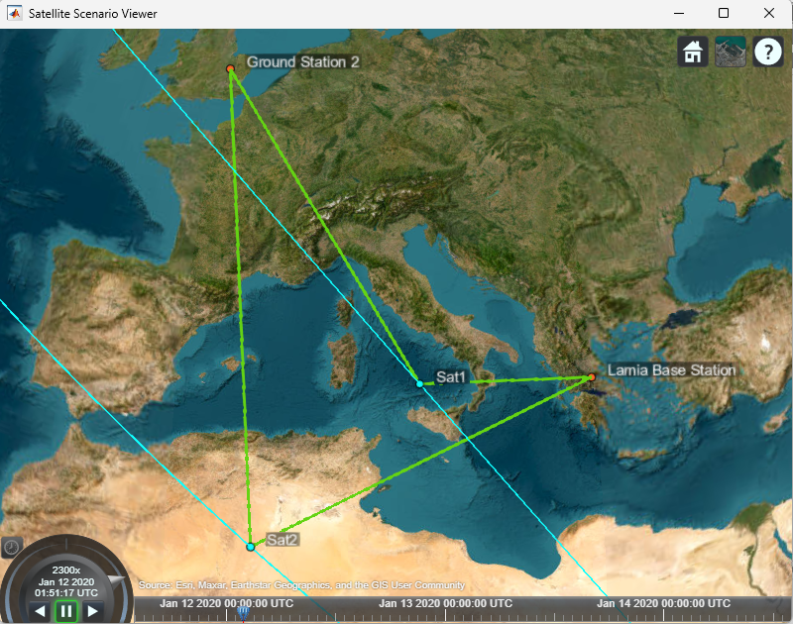
MATLAB Simulation – 3/8
The Scheme of communication is:
Each Base Station has two gimbals.
BS1 is in Lamia, is the receiver.
BS1 in United Kingdom is transmitter.
All Passes and Links are evaluated when both satellites are visible!

Slide 7
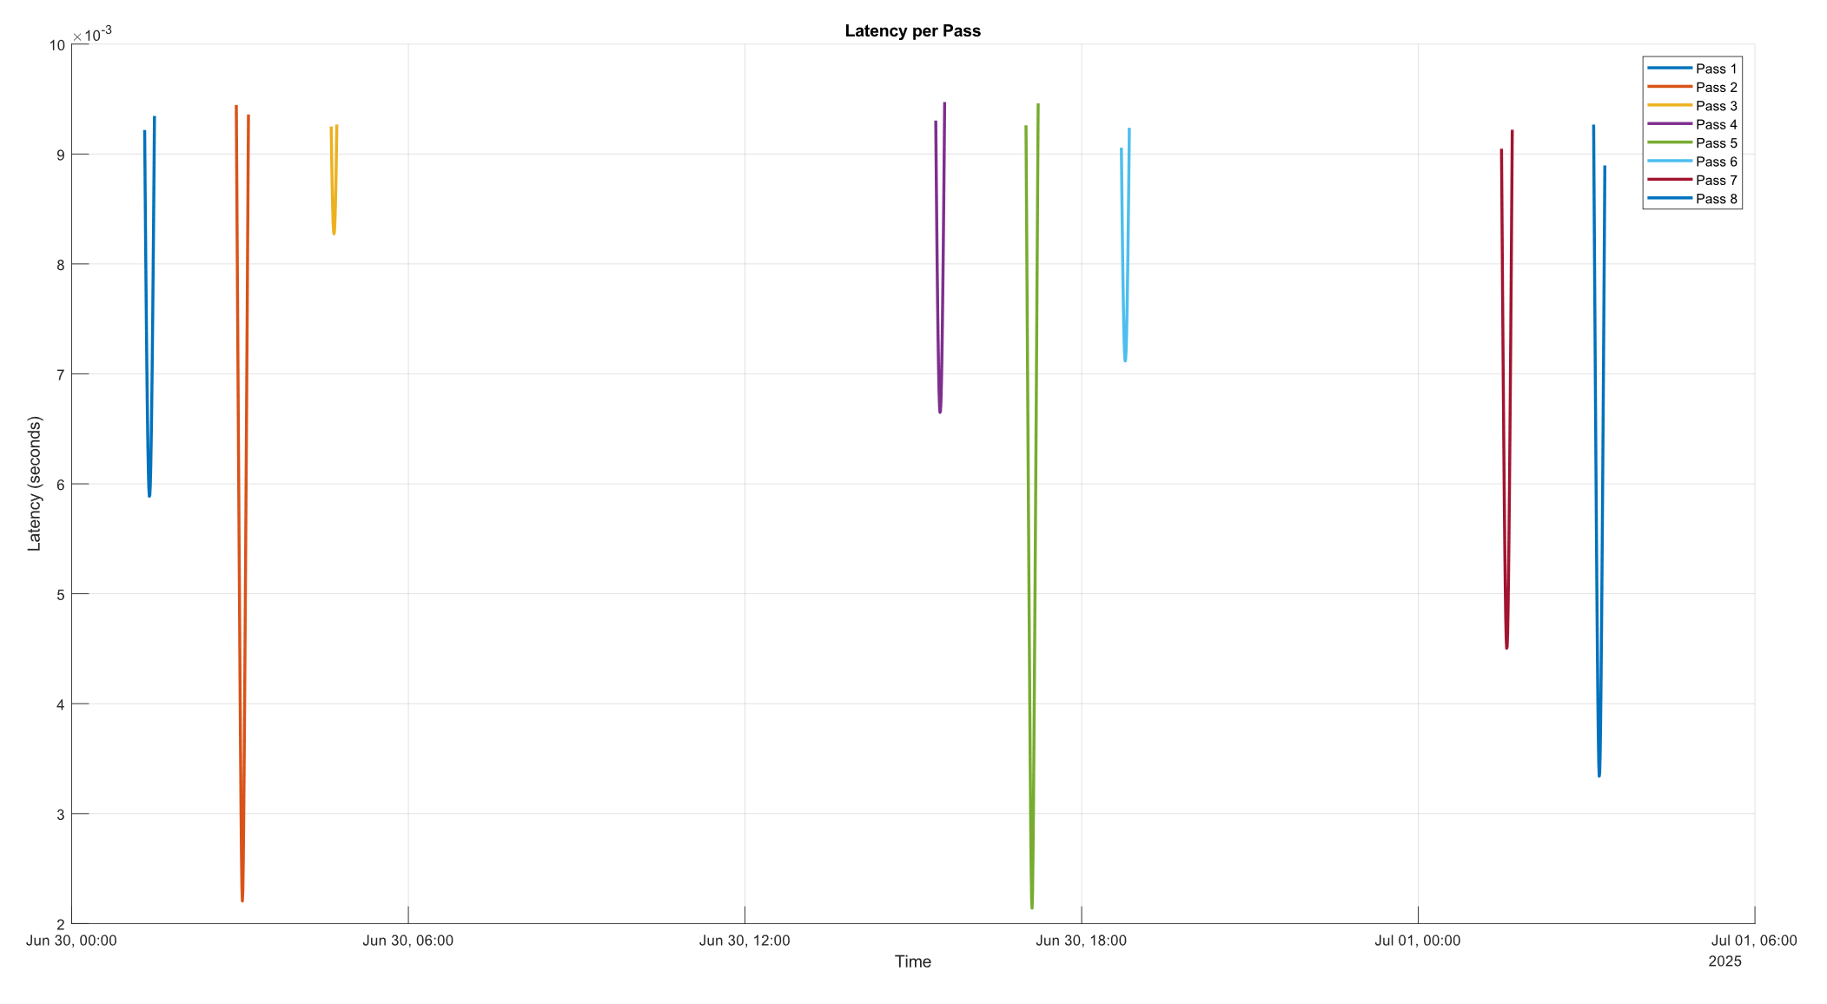
MATLAB Simulation – 4/8

Slide 8
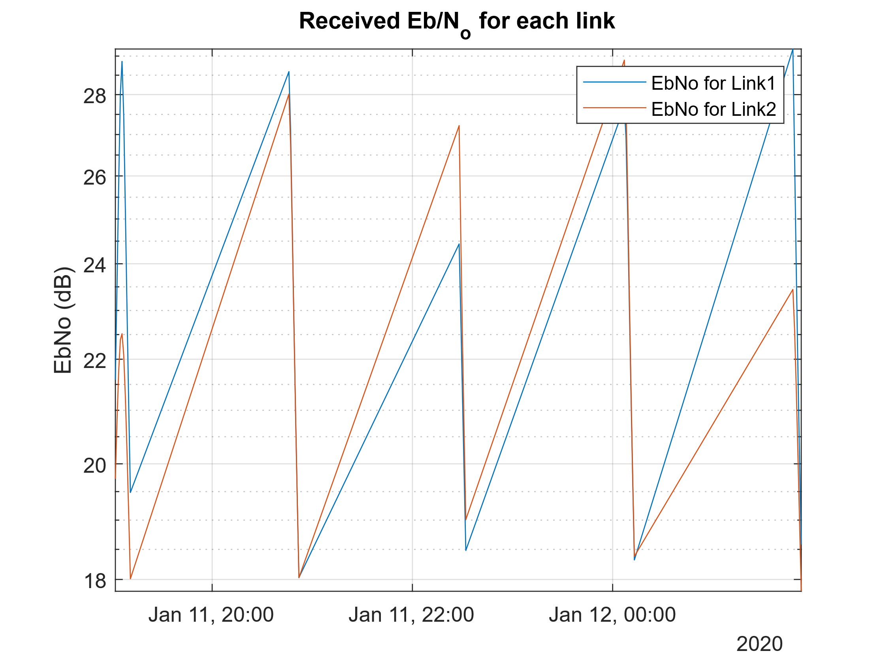
MATLAB Simulation – 5/8

Slide 9
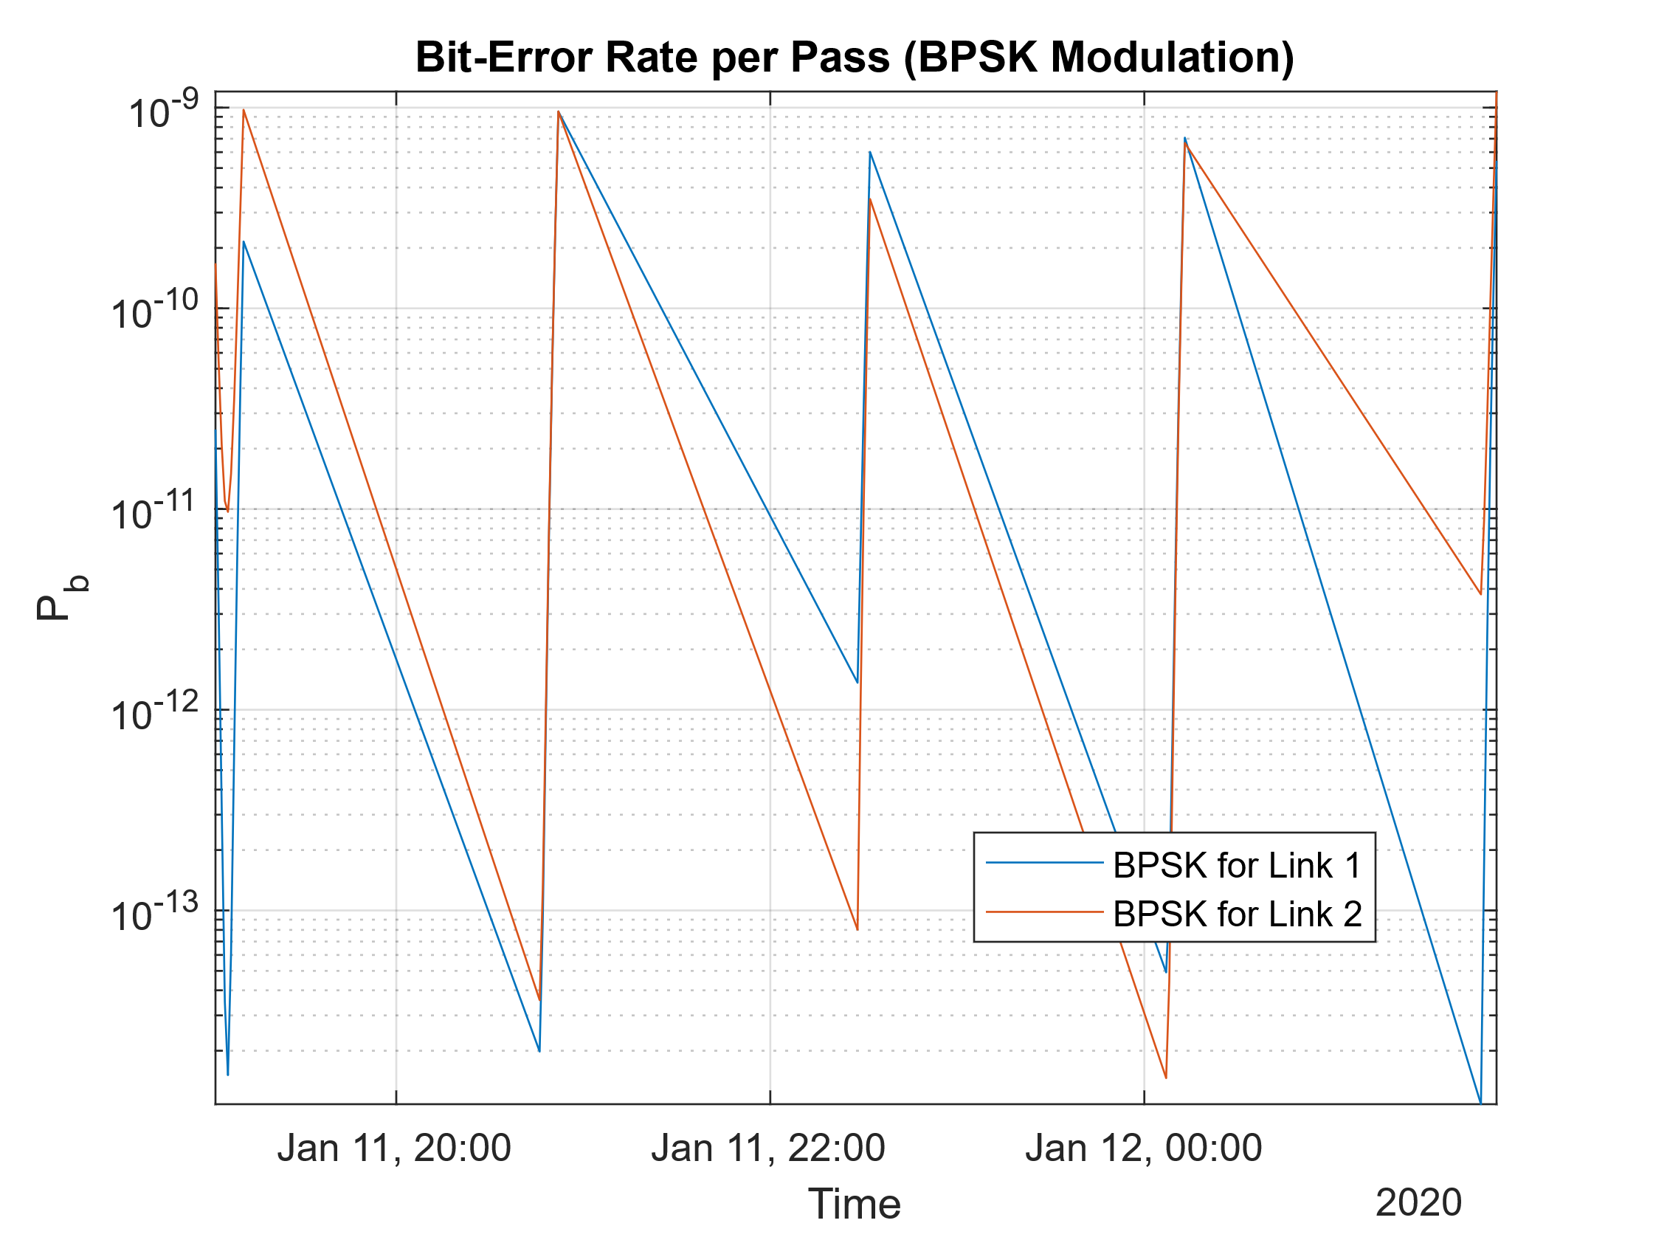
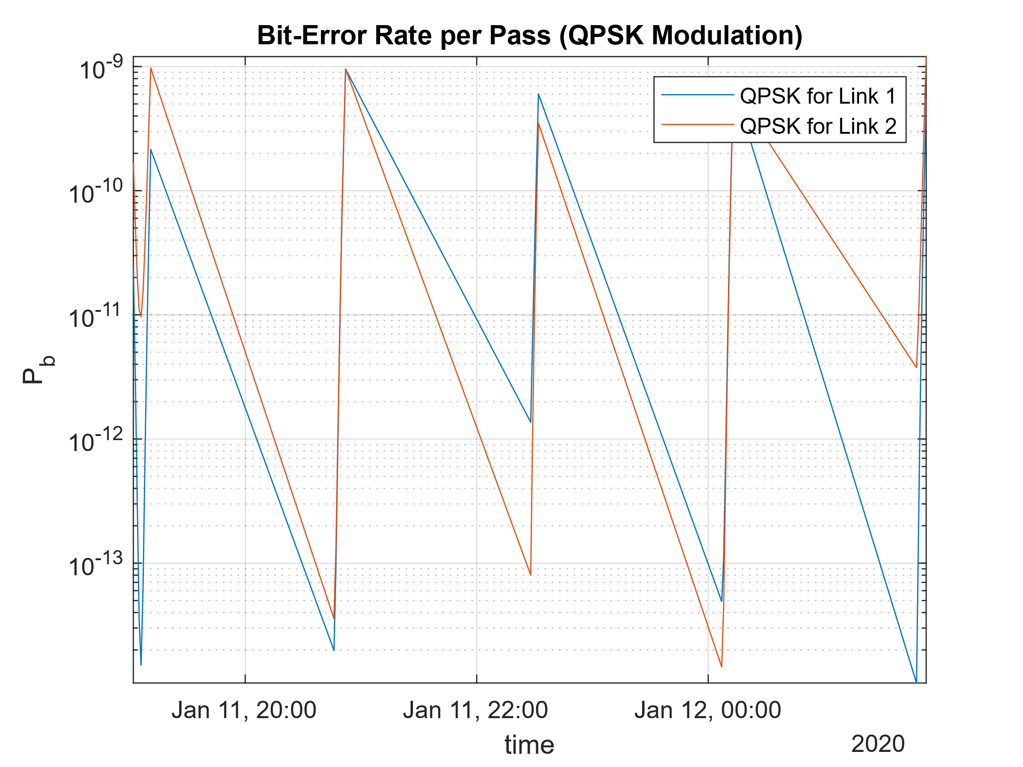
MATLAB Simulation – 6/8

Slide 10
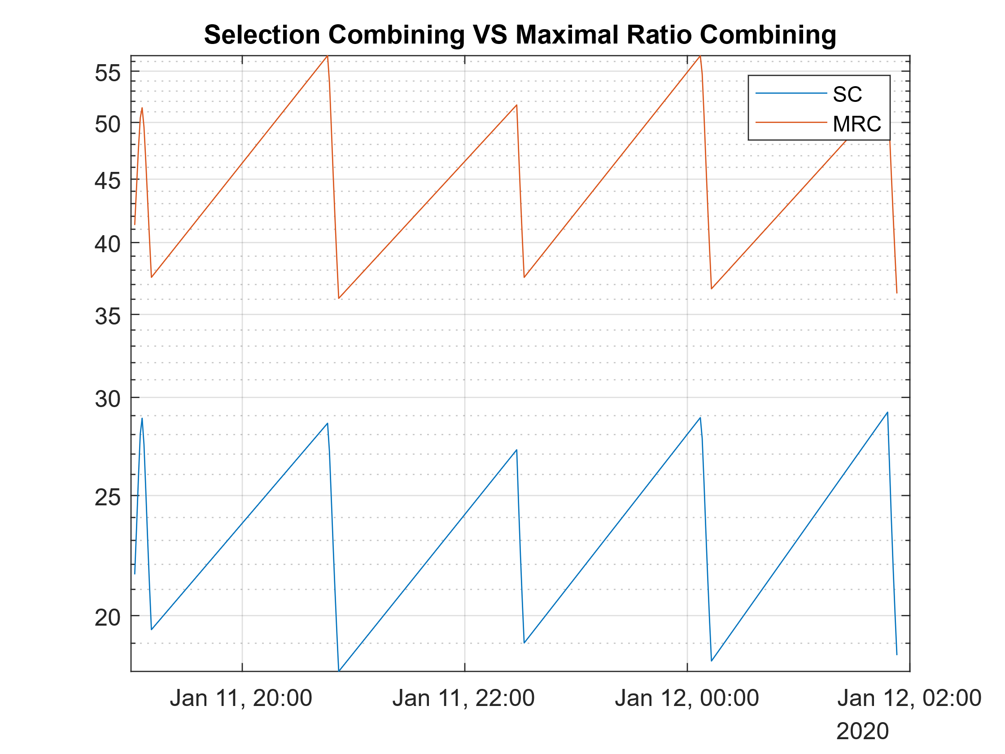
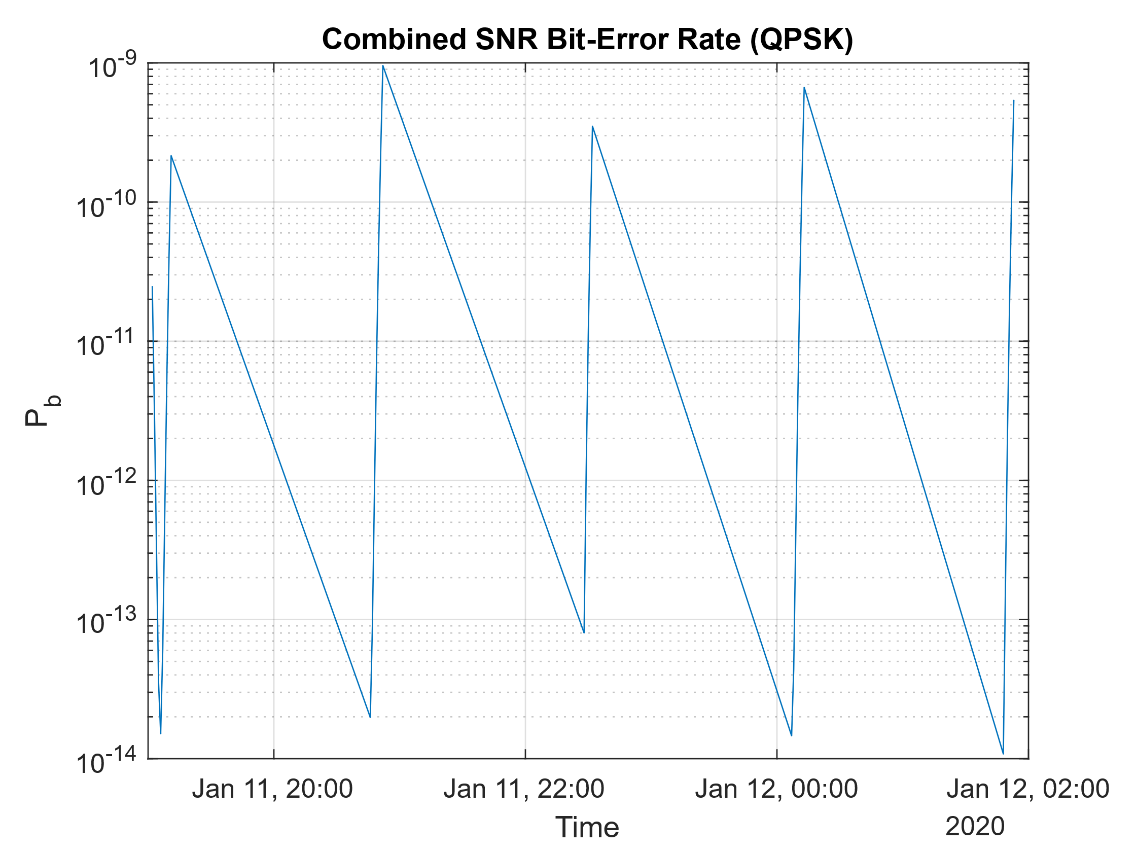
MATLAB Simulation – 7/8

Slide 11
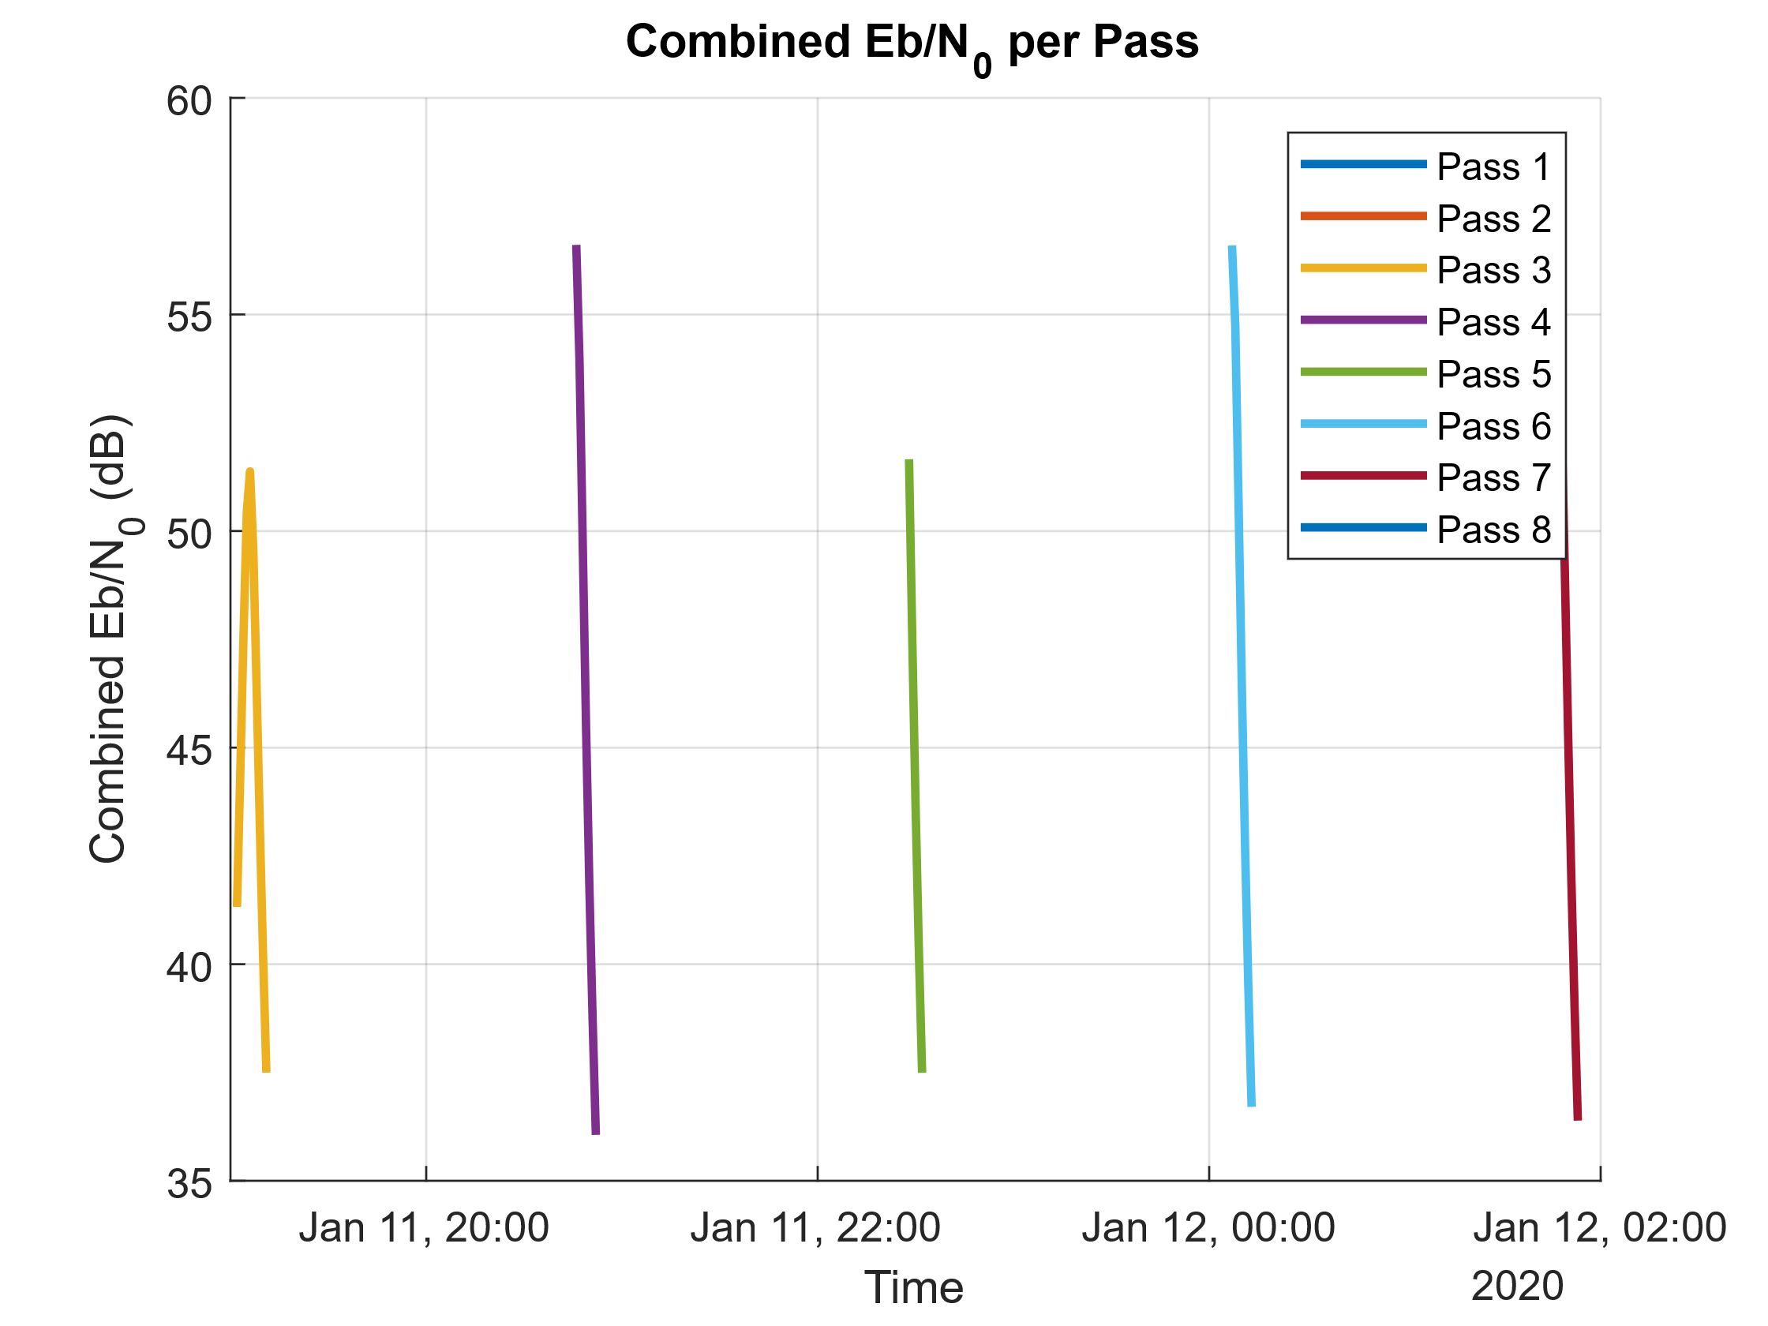
MATLAB Simulation – 7/8

Slide 12
Open Issues
Adding Fading to the Satellite Toolbox Models.
Evaluation of the System Model in proceed in detailed mathematical modeling.
Pure matlab simulation of the evaluated system model.
Orbit selection for maximum pass duration (in-view).
Applications on LEO Constellations.
Combination with IoT-over-Satellite Research.
Combination with the NTN-IAB-Simulator.

Slide 13
